Slide 1
Impact of the Atlantic Multidecadal Oscillation on Baltic Sea variability
Florian Börgel¹ , Claudia Frauen¹ , Thomas Neumann¹ , S. Schimanke²,
H. E. Markus Meier^{1,2}
submitted to Geophysical Research Letters, 2018
¹ Leibniz Institute for Baltic Sea Research, Warnemünde, Germany
² Swedish Meteorological and Hydrological Institute, Norrköpping, Sweden
florian.boergel@io-warnemuende.de
1

Slide 2
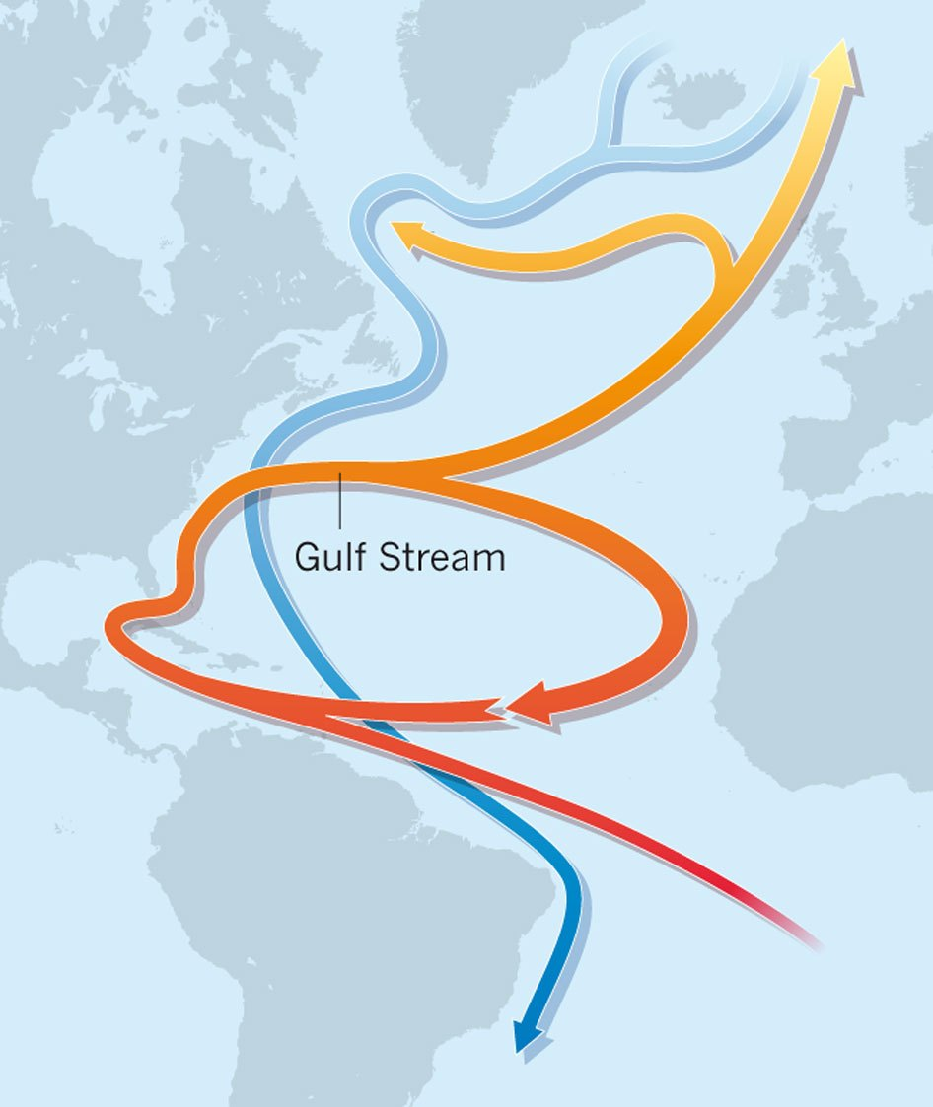
Atlantic Meridional Overturning Circulation
Northward flow of warm, salty water in the upper layers of the Atlantic
Southward flow of colder, deep waters
2
Schematic Representation of the Atlantic Meridional Overturning Circulation (Nature, 2012)
Notes:
In other words:
Heat transport from the tropics toward the North Atlantic where the heat is transferred to the Atmosphere.
In other words:
Heat transport from the tropics toward the North Atlantic where the heat is transferred to the Atmosphere.

Slide 3
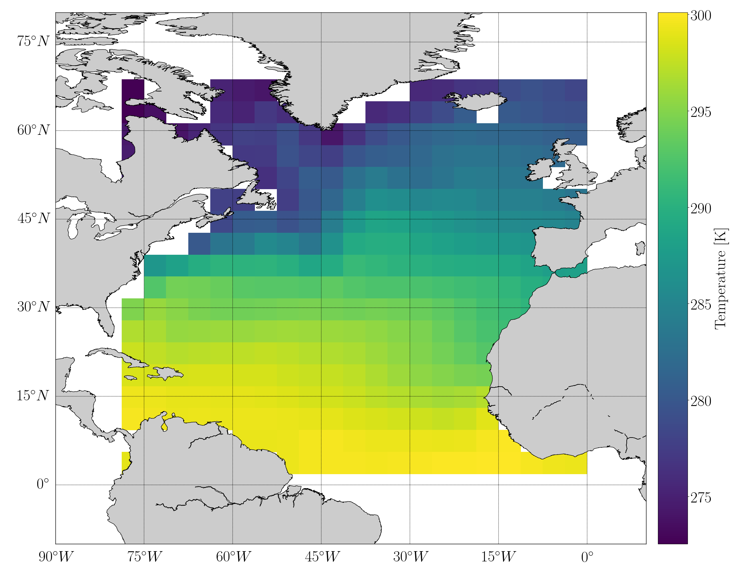
What is the AMO?
The AMO is said to be a coherent periodic signal in the North Atlantic Sea Surface Temperature with a period of 60-90 years
Schematic Representation of the Atlantic Meridional Overturning Circulation (Nature, 2012)
Sea surface temperature for the calculation of the AMO index
3

Slide 4
The impact of AMO states
Atlantic hurricanes (Goldenberg et al., 2001; Knight et al., 2006)
India/Sahel rainfall (Knight et al., 2006)
North American climate (Enfield et al., 2001)
Arctic temperature (Chylek et al., 2009)
Weather regimes over Europe (Zampieri et al., 2017)
4
Notes:
Previous studies have
demonstrated that this basinwide pattern has a large
influence on almost the whole North Hemisphere cli-
mate, for example,
Previous studies have demonstrated that this basinwide pattern has a large influence on almost the whole North Hemisphere climate, for example

Slide 5
Motivation
Impact of the AMO on the Baltic Sea ecosystem
Limited observations of about 150 years
Tracking records of marine species are even shorter (Alheit, 2014)
=> numerical model approach
5
Notes:
With a frequency of 60 - 90 years, effects of the AMO are hard to evaluate since observations are limited to about 150 years.
Tracking records of marine species are even shorter, making statistically significant analyses impossible.
One way to avoid this lack of data is to use numerical models. However, Still, GCMs are necessary to make statistically significant statements about a possible impact of the AMO on the Baltic Sea ecosystem.\\
One way to overcome these limitations is to se a numerical model

Slide 6
Ocean model and forcing
Regional Rossby Centre Ocean model (RCO) to simulate the Baltic Sea from 950 – 1800 (Schimanke and Meier, 2016)
horizontal resolution of 3.7 km and 83 vertical layers with a maximum depth of 250 m
Forcing data: Rossby Centre Atmosphere model (RCA3) with a resolution of 0.44° covering nearly the whole area of Europe (Schimanke, 2012)
RCA3 is driven by the global paleoclimate model ECHO-G at the lateral boundaries (Legutke and Voss, 1999)
6
Notes:
This dynamical downscaling approach of ECHO-G allows to include regional effects, e.g. a better captured geographical distribution of precipitation \
6
Origin of amo in echo-g

Slide 7
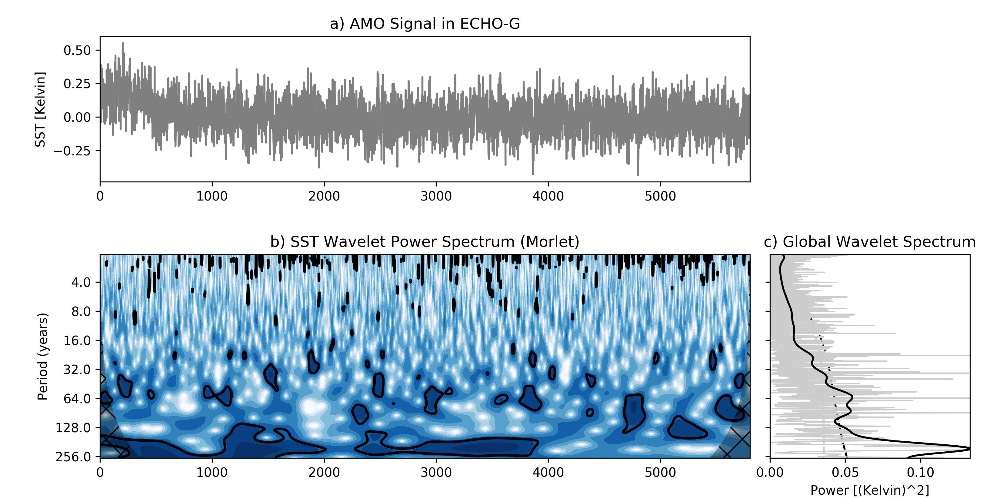
7
Notes:
Power spectrum shows the distribution of power in frequency space. „how much of the signal is a frequency w“

Slide 8
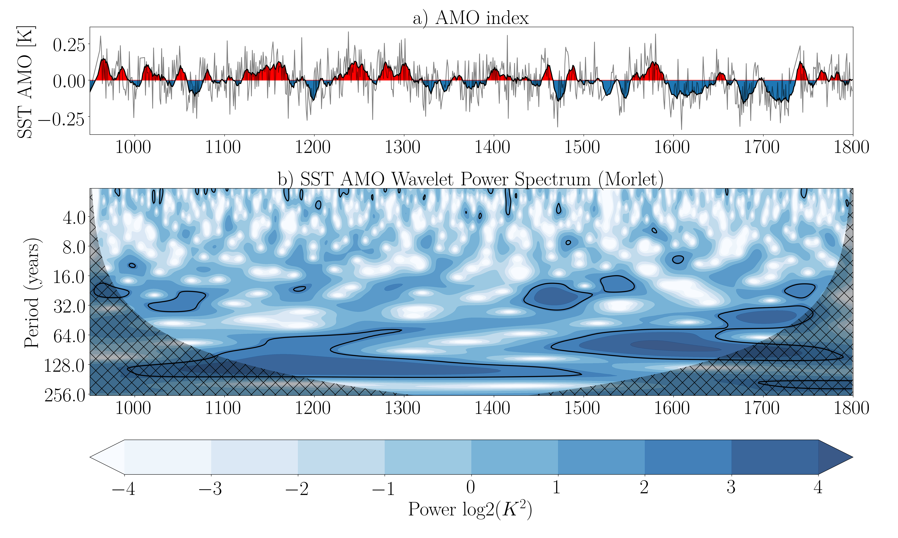
8
Notes:
Ocean mode that is excited by atmospheric noise

Slide 9
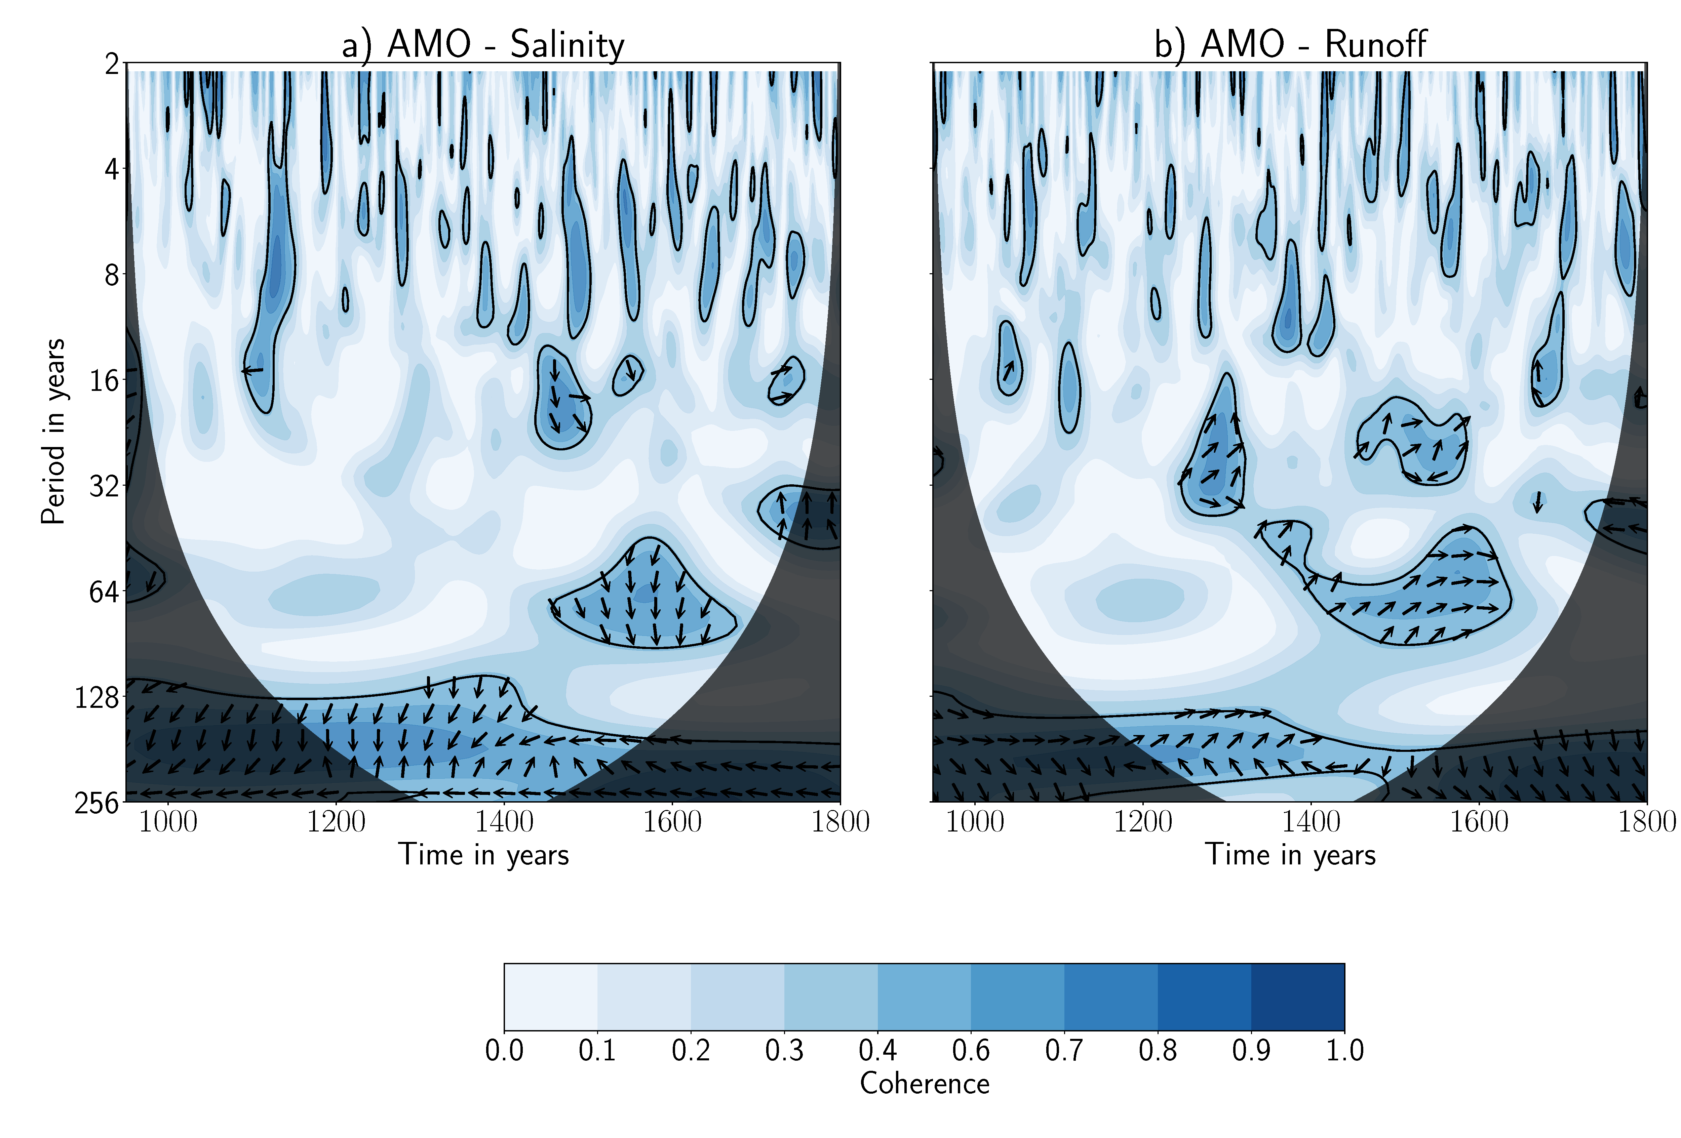
9
Notes:
More than 50%explained variability
Phase relationship

Slide 10
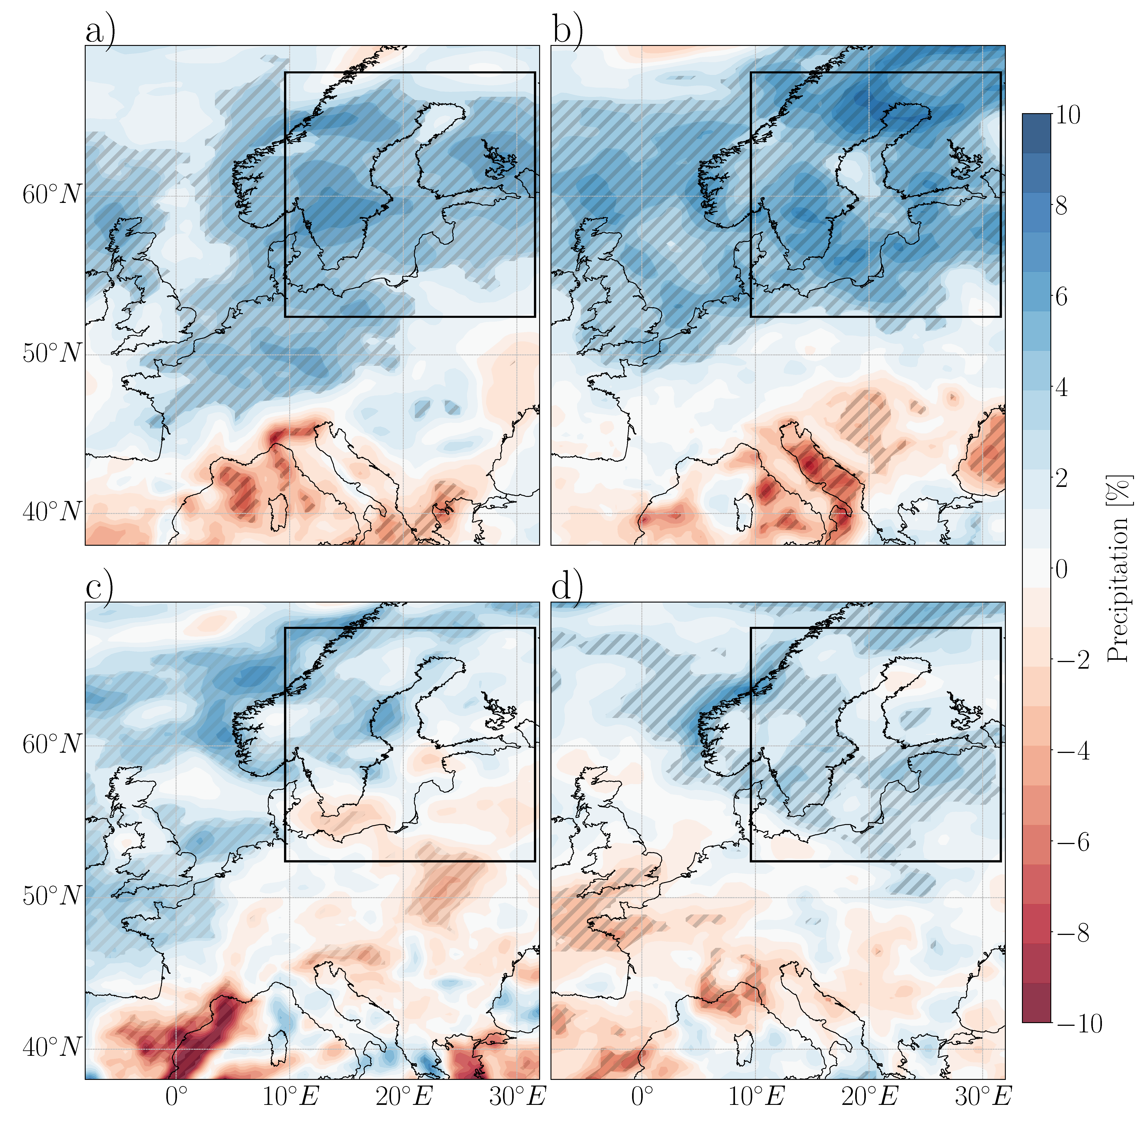
AMO influences the precipitation over the Baltic Sea
Difference in precipitation between AMO+ and AMO-. a) winter (DJF), b) spring (MAM), c) summer (JJA), d) autumn (SON). The scale shows the relative difference to the local seasonal mean. Statistical significant regions are hatched.
10

Slide 11
Mean SLP in winter a),
SLP difference between AMO+ and AMO- winter b), mean SLP spring c),
difference spring d)
11

Slide 12
Conclusions
Dynamical downscaling of global paleoclimate simulation ECHO-G shows the impact of AMO on the Baltic Sea
AMO-induced changes in the atmospheric circulation impact the precipitation over the Baltic Sea catchment area
12

Slide 13
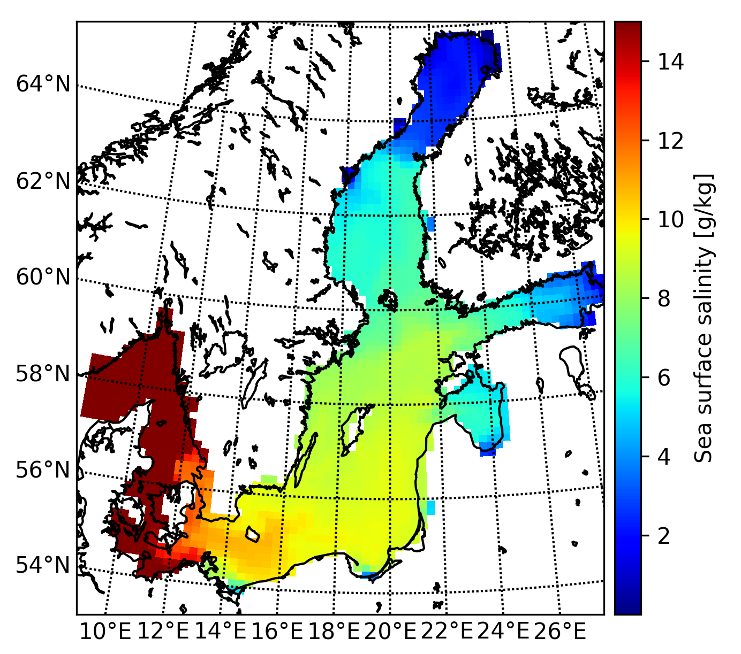
Conclusions
Precipitation affects river runoff which in turn affects the mean salinity causing multi-decadal salinity changes of 0.8 g/kg
Horizontal salinity gradient affects the species distribution
13

Slide 14
References
S. Goldenberg, C. Landsea, Alberrto Mestas-Nuêz, William M. Gray: The Recent Increase in Atlantic Hurricane Activity: Causes and Implications, Science, Volume293(5529):474-479, July 20, 2001
Knight, J. R., C. K. Folland, and A. A. Scaife (2006), Climate impacts of the Atlantic Multidecadal Oscillation, Geophys. Res. Lett., 33, L17706, doi: 10.1029/2006GL026242.
Enfield, D. B., A. M. Mestas-Nunez, and P. J. Trimble (2001), The Atlantic multidecadal oscillation and its relation to rainfall and river flows in the continental U.S., Geophys. Res. Lett., 28(10), 2077–2080.
Chylek, P., C. K. Folland, G. Lesins, M. K. Dubey, and M. Wang (2009), Arctic air temperature change amplification and the Atlantic Multidecadal Oscillation, Geophys. Res. Lett., 36, L14801, doi: 10.1029/2009GL038777.
M. Zampieri, A. Toreti, A. Schindler, E. Scoccimarro, S. Gualdi, Atlantic multi-decadal oscillation influence on weather regimes over Europe and the Mediterranean in spring and summer, Global and Planetary Change, Volume 151, 2017, 92-100, ISSN 0921-8181, https://doi.org/10.1016/j.gloplacha.2016.08.014.
Schimanke, S. and H. E. M. Meier (2016). Decadal-to-centennial variability of salinity in the Baltic Sea. J. Clim. 29: 7173-7188, doi: 10.1175/jcli-d-15-0443.1
Schimanke, S., H. E. M. Meier, E. Kjellström, G. Strandberg and R. Hordoir, 2012: The climate in the Baltic Sea region during the last millennium. Climate of the Past, 8, 1419- 1433, doi:10.5194/cp-8-1419-2012.
Legutke, S. and R. Voss, 1999: The Hamburg Atmosphere-Ocean Coupled Circulation Model ECHO-G. Technical report, No. 18, German Climate Computer Centre (DKRZ), Hamburg, 62 pp.
14

Slide 15
Questions?
15

